Slide 1


Slide 2
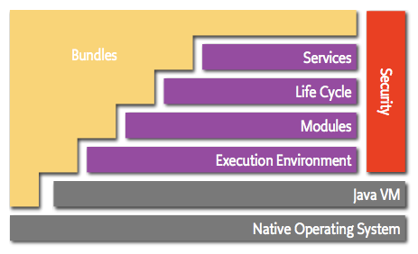
OSGi Security
How the security works?

Slide 3
OSGi Security
What Security Defined in the OSGi Spec?
Makes use of Protection Domain
The stack walk based Permission Check
Signed bundles
User based security is supported by the UserAdmin service but not integrated in the standard permission check as with JAAS
Additionally, PermissionAdmin and ConditionalPermissionAdmin provide sophisticated management infrastructure

Slide 4
OSGi Security
What Security is Not Defined in the OSGi Spec?
Truly cross-cutting security apart from Java 2 Security
Java Authentication and Authorization Service (JAAS) integration
Securing the container from bad people
An easy way to apply user-based, declarative access protections
No @annotations
Only programmatic security (With BundleListener, Waewing we can provide info)
Not declarative

Slide 5
OSGi Security
Sources of permissions
Java 2 Security Policy
System permission - Dynamic (programmatic) configuration of the ConditionalPermissionAdmin and PermissionAdmin
Local Permissions. (Static, per bundle policy) the “maximum” permission of bundle defined on OSGI-INF/permissions.perm
Implicit permission – minimum permission to operate with OSGi framework (like being able to read the org.osgi.framework.* system properties)

Slide 6
OSGi Security
Effective Permissions
The effective permissions are the set of permissions that are checked at runtime:
effective = (java ∩ local ∩ system) ∪ implicit

Slide 7
OSGi Security
Java 2 Security
Enable Security Manager
-Djava.security.manager
Define security policy in policy file
-Djava.security.policy=<file>
Create custom permissions or use java.security.BasicPermission
new BasicPermission(“displayReports”);
Check permissions in protected code segments
SecurityManager sm = System.getSecurityManager();
if (sm != null)
sm.checkPermission(new BasicPermission(“displayReports”));

Slide 8
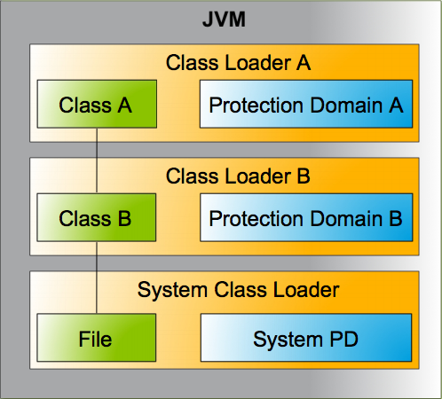
OSGi Security
Java 2 Security Protection Domains

Slide 9
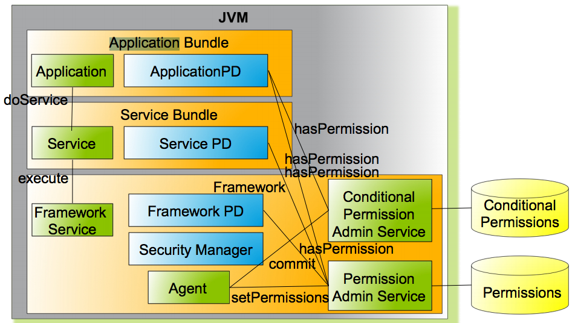
OSGi Security
OSGi Permission workflow

Slide 10
OSGi Security
Permission Admin - Permission Info
Encapsulates three pieces of information
type - class name of the permission
name - name argument of the permission
actions - actions argument of the permission
PermissionAdmin admin = getPermissionAdmin();
admin.setPermissions(context.getBundle().getLocation(),
new PermissionInfo[]{
new PermissionInfo(
AllPermission.class.getName(), ””,"")});
PermissionInfo[] previous = admin.getDefaultPermissions();
admin.setDefaultPermissions(new PermissionInfo[0]);
// unset
admin.setDefaultPermissions(previous);

Slide 11
OSGi Security
Permission Admin - OSGi specific permissions
OSGi specifications define special permissions for
framework and service related tasks
The core framework specification defines:
AdminPermission - for all framework specific actions
PackagePermission - for package import and export
ServicePermission - for service providing and usage
BundlePermission - for extensions/fragments
Custom permissions can be used if they have been exported by a bundle or the classpath

Slide 12
OSGi Security
Permission Admin - Package Permission
A bundle‘s authority to import/export a package
Name is the package as dot-separated string (Wildcards are supported)
Two actions: EXPORT and IMPORT (EXPORT implies IMPORT)

Slide 13
OSGi Security
Permission Admin - Service Permission
A bundle‘s authority to register/get a service
Name is the name of the service interface as a dot separated string
Wildcards may be used for the classname
Two Actions: GET and REGISTER

Slide 14
OSGi Security
Permission Admin - Bundle Permission
A bundle‘s authority to require/provide/attach a
bundle/fragment
Name is the bundle symbolic name
Wildcards may be used
Four Actions: PROVIDE, REQUIRE, HOST, and FRAGMENT (PROVIDE implies REQUIRE)

Slide 15
OSGi Security
Permission Admin - Admin Permission
A bundle‘s authority to perform specific privileged
administrative operations or get sensitive
informations about a bundle.
Name is a filter expression. The filter gives access to the following parameters:
signer - A DN chain of bundle signers
location - The location of a bundle
id - The bundle ID of the bundle
name - The symbolic name of a bundle
Example: "(&(signer=ge)(name=com.ge.*)(location=file://*)(id>=10))"

Slide 16
OSGi Security
Permission Admin - Admin Permission
There are eleven Actions:
class - load a class from a bundle
execute - start/stop bundle and set bundle startlevel
extensionLifecycle - manage extension bundle
lifecycle - manage bundle (update/uninstall/etc.)
listener - add/remove synchronous bundle listeners
metadata - get manifest and location
resolve - refresh and resolve a bundle
resource - get/find resources from a bundle
startlevel - set startlevel and initial bundle startlevel
context - get bundle context

Slide 17
OSGi Security
Conditional Permission Admin
New (4.0) way of doing permission management
Recommended to use this exclusively for new implementations
Interoperability when both PermissionAdmin and ConditionalPersistenceAdmin service are presented
IF all conditions of a set of conditions match THEN apply the supplied permissions
More flexible, extensible model
Conditions evaluation is highly optimized

Slide 18
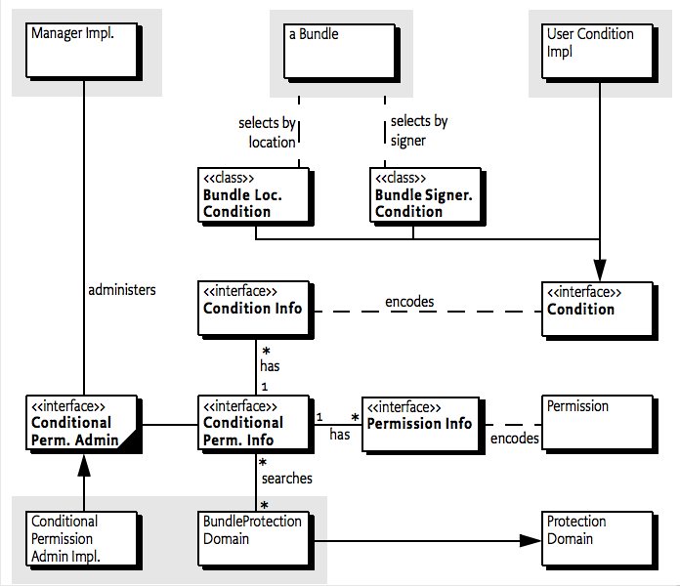
OSGi Security
Conditional Permission Admin

Slide 19
OSGi Security
Conditional Permission Admin - Conditions
Purpose is to decide if a permission set is applicable or not.
Can be postponed or immutable
Allows optimized evaluations
Custom conditions can be used for more advanced use-cases

Slide 20
OSGi Security
Conditional Permission Admin - BundleLocationCondition
Condition to test if the location of a bundle
matches a pattern. Matching is done based on filter string matching rules
ConditionalPermissionAdmin condPermAdmin = getConditionalPermissionAdmin();
condPermAdmin.addConditionalPermissionInfo(
new ConditionInfo[] {
new ConditionInfo(
BundleLocationCondition.class.getName(),
new String[]{"*://www.ge.com*"})
},
new PermissionInfo[] {
new PermissionInfo(
AdminPermission.class.getName(),
"(!(id=" + context.getBundle().getBundleId() + "))",
"*")
});

Slide 21
OSGi Security
Conditional Permission Admin - BundleSignerCondition
Condition to test if the signer of a bundle matches a pattern – Uses the wildcard matching
new ConditionInfo(BundleSignerCondition.class.getName(),
new String[]{"*,o=GE"})

Slide 22
OSGi Security
Conditional Permission Admin - Custom Condition
Conditions must come from the classpath/system bundle
Are constructed from ConditionInfo objects (Factory)
static getCondition(Bundle,ConditionInfo) method
constructor with (Bundle, ConditionInfo) signature

Slide 23
OSGi Security
Conditional Permission Admin - Custom Condition
class BeforeDateCondition implements Condition {
private final long m_date;
public static Condition getCondition(Bundle bundle, ConditionInfo info) {
return new BeforeDateCondition(bundle, info);
}
public BeforeDateCondition(Bundle bundle, ConditionInfo info) {
m_date = Long.parseLong(info.getArgs()[0]);
}
public boolean isMutable() {
return m_date > System.currentTimeMillis();
}
public boolean isPostponed() {
return false;
}
public boolean isSatisfied() {
return System.currentTimeMillis() < m_date;
}
public boolean isSatisfied(Condition[] conditions, Dictionary context) {
return false;
}
}

Slide 24
OSGi Security
Conditional Permission Admin – ConditionalPermissionInfo
// grant self all permissions
String permTemplate =
"ALLOW {" +;
"[ org.osgi.service.condpermadmin.BundleLocationCondition \"%s\" ]" +
"( java.security.AllPermission \"*\" \"*\" )" +
"} \"Management Agent\"";
String permStr = String.format(permTemplate,
bundleContext.getBundle().getBundleLocation());
ConditionalPermissionInfo p1 = conPermAdmin.newConditionalPermissionInfo(permStr);
perms.add(p1);

Slide 25
OSGi Security
Local Permissions
Defined in a resource inside the bundle
Defines a set of permissions that are enforced by the framework
A bundle can get less than these permissions, but never more
Defaults to All Permissions
an empty file “OSGI-INF/permissions.perm” to a bundle, and apart from some implict permissions (e.g. to import packages, read/write the bundle configuration area), that bundle has had its permissions entirely removed.
Good way for operators to “audit” the permissions of a bundle

Slide 26
OSGi Security
Local Permissions
OSGI-INF/permissions.perm
( ..ServicePermission "..log.LogService" "GET" )
( ..PackagePermission "..log" "IMPORT" )
( ..ServicePermission "..cm.ManagedService" "REGISTER" )
( ..PackagePermission "..cm" "IMPORT" )
( ..ServicePermission "..useradmin.UserAdmin" "GET" )
( ..PackagePermission "..cm" "SET" )
( ..PackagePermission "com.acme.chess" "IMPORT,EXPORT" )
( ..PackagePermission "com.acme.score" "IMPORT" )
( java.io.FilePermission “/Users/*” “read”)

Slide 27
OSGi Security
Final Thoughts
This looks great for reducing the risks from exploits in bundles, but clearly doesn’t help much with 3rd party bundles, which is where the Conditional Permission Service should come into its own.

Slide 28
OSGi Security
Links
http://securesoftwaredev.com/2012/11/19/permissions-in-osgi/
http://log.illsley.org/2010/11/29/osgi-java-security-manager-and-keeping-things-simple/
http://www.osgi.org/javadoc/r4v43/core/org/osgi/service/condpermadmin/package-summary.html
https://github.com/ouertani/sosgi/blob
http://java.dzone.com/articles/osgi-security-fly
/f6a6b14a90e44b81febab3aa5d700688dd142fae/src/main/scala/impl/SecurityManager.scala
http://felix.apache.org/site/apache-felix-framework-security.html
http://felix.apache.org/site/presentations.data/Building%20Secure%20OSGi%20Applications.pdf
http://jazoon.com/history/Portals/0/Content/slides/tu_a7_1400-1450_smith.pdf

Slide 29
OSGi Security
Links
https://github.com/robertcsakany/welcometoosgi

Slide 30
KÖSZÖNÖM A FIGYELMET!

